Slide 1
Data Types
Programming languages need a variety of data types in order to better model/match the world
  more data types make programming easier but too many data types might be confusing
    which data types are most common?
    which data types are necessary?
    which data types are uncommon yet useful?
  how are data types implemented in the various languages?
Almost all programming languages provide a set of primitive data types
  primitive data types are those not defined in terms of other data types
  some primitive data types are implemented directly in hardware (integers, floating point, etc) while others require some non-hardware support for their implementation such as arrays

Slide 2
Language Support of Data Types
Historically, we see the following:
  FORTRAN only had numeric types and arrays
  COBOL introduced advanced record structures, character strings and decimal
  Lisp had built-in linked lists
  PL/I was the first language to offer a wide range of types but did not allow for tailor-made types
  ALGOL 68 took a different approach by offering few types but these types were combinable into many advanced types
    strings = arrays + chars
    lists, trees, queues, stacks, graphs, sets = records + pointers or arrays
Most languages since ALGOL have adopted ALGOL’s approach – few basic types that can are used to define a greater variety
  later on, the notion of abstract data types and even later, object-oriented programming, expanded on these ideas
    we study these concepts in chapters 11 and 12
Notes:
Recall in C, you can create a data structure by combining structs and pointers:
struct node {
…;
struct node *next; };
struct node *front;
The facility to create structures through primitive types was first pioneered in Algol 68. You might recall that C and Pascal were descendants of Algol 68. Up until Algol 68, most languages restricted the data structures available to built-in types (COBOL had records, Lisp had lists, PL/I had just about everything, FORTRAN had almost nothing). But after Algol 68, it was common for languages to have a “build-it yourself” facility.
Later, encapsulation and information hiding were introduced to lead us to abstract data types, and even later, inheritance and polymorphism to lead us to OOP. We cover these concepts in chapters 11 and 12. For now, we look at the typical built-in data structures.

Slide 3
Primitive Data Types
Types supported directly in hardware of the machine
  Integer: byte, short, int, long, signed, unsigned
  Floating Point: single and double precision
    stored in 3 parts: sign bit, exponent, mantissa
  Complex: numbers that contain an imaginary part
    available in languages like Common Lisp, FORTRAN and Python
  Decimal: BCD (2 decimal digits per byte)
    for business processing whereby numbers (dollars and cents) are stored as 1 digit per ½ byte instead of using an int format
    popularized in COBOL, also used in PL/I and C#
  Boolean: 1-bit value (usually referenced as true or false)
    available in C++, Java, Pascal, Ada, Lisp, but not C
    in Lisp, the values are T or NIL
    for hardware convenience, these are often stored in 1 byte or 1 word!
  Character: ASCII or Unicode
    IBM mainframes use a different code called EBCDIC
    Java, Javascript C# support Unicode
Notes:
NOTE: primitive here is not the same as how we use it when referring to the primitive types in Java even though they are mostly the same types. By primitive, we mean directly supported by hardware. Strings do not appear in this list because strings are rarely supported directly in hardware, instead they are stored as individual characters and linked together through some mechanism implemented by the programming language (usually as arrays of characters).
What about pointer types? You’ll notice that they do not appear above. Typically, pointers are just unsigned int values. But we treat pointers differently than ints because we do not permit pointer arithmetic (except in a few languages) and require dereferencing of some kind. Dereferencing may be directly supported in hardware by having indirect addressing modes.

Slide 4
Types Found in PL/I
We briefly look at PL/I types because of the wide range and depth
  Numeric types:
    Fixed decimal (like BCD, with specified length and decimal point)
    Fixed binary (same but values specified in binary)
    Float decimal/binary (true floating point, including integers)
    Zoned decimal (any form of number used for output to files)
    Complex
  Non-numeric types:
    Character, Bit, Pointers, Builtin – when requesting a piece of built-in information such as calling the function DATE or TIME
  Structures:
    Strings indicated by number of Characters, “varying” means any length up to a specified maximum as in DCL NAME CHAR(20) VARYING;
    Records – declared much like COBOL records
    Pictures –like COBOL: specified char-by-char (Z, V, 0, 9, .)
    Files
    Lists – circular and bidirectional available
    Binary Tree
    Stack
Notes:
Why is the PL/I approach a bad idea?
Aside from it being complicated, there is no capacity to build your own. What if you wanted a general tree instead of a binary tree? What if you wanted to implement a special kind of list, say one with a dummy header node? PL/I doesn’t allow an ability to tailor your own types based on what was available.

Slide 5
Character Strings
Should a string be a primitive type or defined as an array of chars?
  few languages offer them as primitives (SNOBOL does)
  in most languages, they are arrays of chars (Pascal, Ada, C/C++)
  Java/C# offer them as objects
Design issues:
  should strings have static or dynamic length?
  can they be accessed using indices (like arrays)?
    this is true if the string is treated as an array
  what operations should be available on strings?
    assignment, <, =, >, concat, substring
      available in Pascal/Ada only if declared as packed arrays
      available through libraries in C/C++ and through built-in objects in Java/C#
Character string types could be supported directly in hardware, but in most cases, software implements them as arrays of chars
  so the questions are:
    how are the various operations implemented
      as library routines/class methods or directly in the language?
    how is string length handled?
Notes:
In Pascal and Ada, strings are not primitives but can act as primitives if they are declared as “packed” arrays. In C and C++, strings are arrays of chars and so the only operations are array operation. In Java and C#, strings are objects and have methods to support string operations. SNOBOL, Perl, JavaScript, and PHP all have elaborate pattern matching for strings.

Slide 6
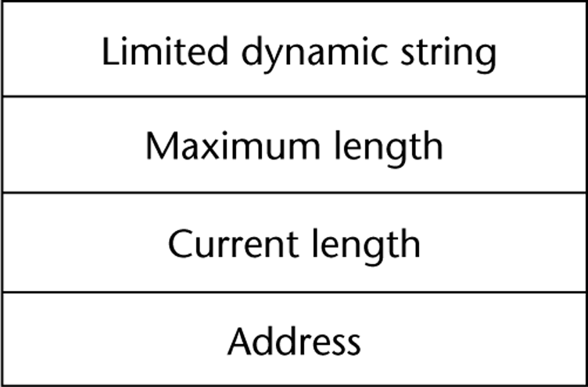
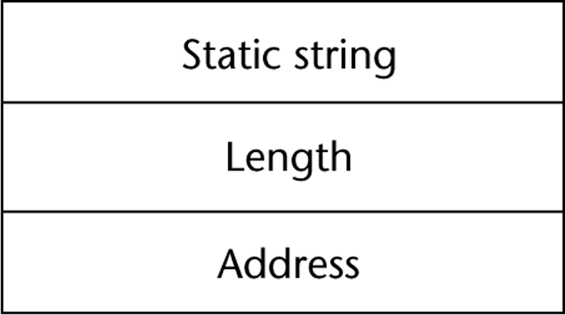
Implementing Strings
Three forms of string lengths:
  Static length strings – string size is set when the string is created
    this is the case with FORTRAN 77/90, COBOL, C#, C++ and Java
    if the string is an object as is the case in Java, and possibly in C#/C++, strings are immutable
  Limited dynamic length strings – string lengths can vary up to a specified limit, for instance, if we declare the string to be 50, it can hold up to 50 chars
    this is the case with Pascal, C, C++, PL/I
  Dynamic length strings – strings can change length at any time with no maximum restriction
    this is the case with SNOBOL, LISP, JavaScript, Perl
    strings might be stored in a linked list, or as an array from heap memory which needs a lot of memory movement as the string grows
Most languages generate a descriptor for every compiled string
    The dynamic string requires dynamic
    memory but only uses a single current
    length field for the length

Slide 7
Ordinal Types
Ordinal: countable, or where the items have an ordering
Does the language provide a facility for programmers to define ordinals?
  ordinal types can promote readability
  programmers provide symbolic constants (names)
  often used in for-loops and switch statements
Languages which support Ordinal types:
  C and Pascal were the first two languages to offer this, C++ cleaned up C’s enum type
  Pascal includes operations PRED, SUCC, ORD
  C/C++ permit ++ and --
  in C#, enum types are not treated as ints
  Java does not include ordinals but can be simulated through proper class definitions
  FORTRAN 77 can simulate enums through constants
Another form of user-defined ordinal type is the subrange
  limited range of a previously defined ordinal type
  introduced in Pascal and made available in Ada
  for example: use .. to indicate the subrange as in 0..5
  subranges require compile-time type checking and run-time range-checking
  subranges have not been made available in the C-like languages
Notes:
I personally am not a fan of ordinal types. You can not easily input or output the values. Consider the following code:
enum days {Sun, Mon, Tue, Wed, Thu, Fri, Sat};
for(days i=Sun;i<Sat;i++)
printf(“%d\n”, i);
What is output? 0..6, not Sun..Sat.
In Pascal or Ada, outputting an ordinal value causes a syntax error. In C, the output statement provides the integer representation, which is not going to be very helpful. In none of these languages are we allowed to input a value like Mon. Instead, we must input a string and then test to see if the string is equal to one of the given enumerated values (symbolic constants)
For instance,
scanf(“%s”, day);
if(strcmp(day, “Mon”)==1) i=1; else…

Slide 8
Array Types
Arrays are homogenous aggregate data elements
  design issues include:
    what types are legal for subscripts?
    when are subscript ranges bound?
    when does array allocation take place?
    how many subscripts are allowed? is there a limit to array dimensions?
    are multi-dimensional arrays rectangular or are ragged arrays allowed?
    can arrays be initialized at allocation time?
    are slices allowed?
Array dimensions:
  FORTRAN I - limited to 3, FORTRAN IV and onward - up to 7
  most other languages have no restriction on array dimensions
    C/C++/Java - arrays are limited to 1 dimension only but arrays can be nested
    this is actually an array of pointers so that you can have as many dimensions as you want
    because the pointers might point to different sized arrays, this can lead to jagged arrays
    most languages restrict you to rectangular arrays (the number of elements for each row are the same)
  C# supports both rectangular and jagged arrays
Notes:
Most languages only permit integer indices (like the C-languages and FORTRAN), but Pascal introduced the ability to use ordinal types as legal subscripts (also found in Modula and Ada)
For instance, if we define array A to use indices of ‘a’ – ‘z’ then, this is legal: A[‘a’] := A[‘b’];
Notice that we differentiate between the type that the array stores and the type of legal index
Pascal and Ada allowed any ordinal type. For instance, if we create a type called days (as we did earlier in C), then we could do something like this:
For i:=Sun to Sat do
A[i] := 1;
A[Sat]:=A[Sun] + A[Mon];
Note that the array A uses the type Days for the type of index, but the array itself is an array of integer values

Slide 9
Indexes
Index maps array element to memory location
  early languages did no run-time range checking, but range-checking is done in most modern languages for reliability
Array indexes are usually placed in some syntactic unit
  [ ] in most languages: Pascal, Modula-2, C-languages
  ( ) in FORTRAN, PL/I, Ada
    parens weaken readability because something like foo(x) is now hard to read – is it a subroutine call or an array access?
  Lisp uses a function as in (aref array 6) to mean array[6]
Most languages separate dimensions by ,
  but C-languages use [ ][ ]
Two types associated with arrays that need to be declared
  the type of value being stored
  the type of value used for an index (in Pascal-like languages)
Are lower bounds automatically set?
  C/C++, Java, early FORTRAN use 0
  1 is used in later FORTRANs
  explicit in all other languages
Notes:
Algol started the idea that arrays would not have to start at 1 and this idea continues in Pascal/Ada/Modula. For instance, you could declare legal indices to be [-10:10] (21 items) or [0:99].
The reason that C/C++/Java/C# start at 0 has to do with making the mapping function easier to implement. We cover the mapping function in a few slides.

Slide 10
Array Subscript Categories
When is the subscript range bound? That is, when is the decision on the size of the array made?
  Static
    subscript range bound before run-time (compile, link or load-time)
    most efficient but most restrictive, the array is fixed in size
    FORTRAN I – 77, C/C++ if declared with the word static
  Fixed Stack-Dynamic
    subscript range is bound at compile time but allocation of the array occurs at run-time from the run-time stack – array size determined when function called
    Ada, Basic, C, C++, Pascal, Java, FORTRAN 90
  Stack-Dynamic
    subscript range dynamically bound and dynamically allocated but remains fixed for lifetime of the array – this allows the array size to be determined at run-time for more efficient space-usage
    Ada if specifically declared this way, ALGOL-60 arrays
Notes:
Static arrays, just like statically bound variables, do not permit recursion. Most languages use fixed stack-dynamic so that the size is known at compile time, but so that memory is allocated at run-time on the stack to permit recursion.
The stack-dynamic form of array subscript means that the array is allocated from the stack but the size is determined at run-time. Thus, you can pass the size needed for the array as a parameter to the subroutine. The main disadvantage here is to set up a specific-sized item to push onto the run-time stack when the subroutine is called. We will cover this in chapter 10.

Slide 11
Language Examples
Fixed Heap-dynamic
  like fixed stack-dynamic except that memory comes from the heap, not the stack, so the size and memory is dynamically allocated, but size is static once created
  C/C++ if allocated using malloc or calloc
  all arrays in Java and C# since they are objects and all objects are allocated from the heap
  FORTRAN 90 and 95
Heap-Dynamic
  dynamically bound and allocated, and changeable during array’s lifetime – the most flexible type of array as it can permit the array to grow or shrink as needed during run-time
  Perl, JavaScript, Lisp
  C# if declared as an object of type ArrayList
  ALGOL-60 could simulate heap-dynamic using the flex command
  Java and C# can simulate heap-dynamic through array copying
Notes:
Notice that far more languages use fixed heap-dynamic than stack-dynamic. Thus, the burden of allocating memory at run-time is placed on the heap (and OS) rather than the run-time stack/language environment. Through fixed heap-dynamic and stack-dynamic, you can specify the size of the array at run-time and therefore create an array whose size might be appropriate, rather than guesswork.
In order to implement heap-dynamic, arrays may not be stored in contiguous locations and therefore access is not via a simple mapping function which results in potentially much poorer performance in accessing any given array element.
Most arrays are homogeneous, but some languages also permit heterogeneous arrays, arrays in which array elements are not (necessarily) the same type
Languages that support this:
Perl (array elements must be scalar types)
Python (array elements are pointers/references to objects)
Common Lisp
JavaScript
Ruby (same as Python)
They are all implemented as heap dynamic arrays
These arrays are sometimes referred to as Tuples (this word originated in Python)

Slide 12
Array Initialization and Operations
Initialization
  FORTRAN 77 offers optional initialization at allocation time (load time)
  C/C++/Java offer optional initialization that can also dictate array size and through initializations, you can create jagged arrays
  in Ada, specific elements can be specified rather than initializing the entire array
  for Pascal, Modula-2, no array initializations
  most languages permit only initialization and access to a single element
Assignment
  Ada, Pascal allow entire array assignment if the arrays are of the same type/size
    Ada also has array concatenation
  in C/C++/Java, assignment is copying a pointer, not duplicating the array
  FORTRAN 95 includes a variety of array operations
    such as +, relational operations (comparisons), matrix multiplication and transpose, etc (all through library routines)
  APL includes a collection of vector and matrix operations (see p 271)

Slide 13
Slices
Definable substructure of an array
  e.g., a row of a 2 D array or a plane of a 3-D array
In FORTRAN:
  Integer Vector(1:10), Matrix(1:10, 1:20)
    Vector(3:6) defines a subarray of 4 elements in Vector
    : by itself is used to denote “wild card” (all elements) in FORTRAN 95 so Matrix(1:5, :) means half of the first dimension and all of the second
FORTRAN 90 & 95 have very complex Slice features such as skipping every other location
  slices can be used to initialize arrays that are different in size and dimension
    for instance, initializing a 1-D array to be the first row of a 2-D array
  slice references can appear on either the left or right hand side of an assignment statement
Ada restricts slices to consecutive memory locations within a dimension of an array for instance, a part of a row
Python provides mechanisms for slices of tuples
  recall Python does not have arrays, instead it has this list-like constructs that can be heterogeneous
Notes:
Here are some examples of slices and how they would be defined in terms of FORTRAN array subscripts:

Slide 14
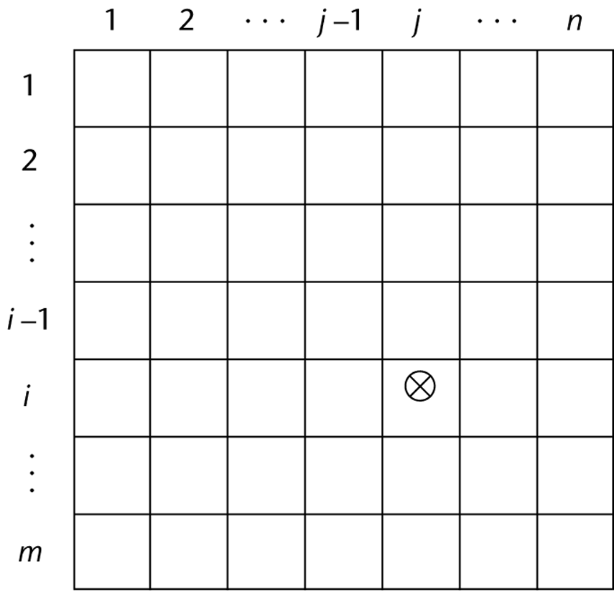
Array Implementations
Arrays are almost always a contiguous block of memory equal to the size needed to store the array
  each successive array element is stored in the next memory location
We define a mapping function which translates the array indexes to the memory location, for instance a 1-D array in C maps as
  a[i] = OFFSET + i * length
    OFFSET is the starting point of the array and length is the size in bytes of each element
    if the language has a lower bound of 1, then we change the above to be (i – 1)
Multi-dimensional arrays in C-languages are altered to include the memory used by all previous rows:
    a[i][j] = OFFSET + i * n * length + j * length
That is, the array element at [i, j] has i previous rows of n
(including row 0) items each, and j elements in the current row
More generically, for languages that allow for a non-0 lower bound, we would use a[i, j] = OFFSET + (i – lower_{i}) * n * length + (j – lower_{j}) * length
Notes:
In C languages, array names are actually pointers and 2-D arrays are arrays of pointers. However, if the arrays are rectangle, the mapping function still holds. If we have a jagged array however, then we need multiple mapping functions.

Slide 15
More on Mapping
Most languages use row-major order
  in row-major order, all of row i is placed consecutively, followed by all of row i+1, etc.
    FORTRAN is the only common language to instead use column-major order (see pages 274-275 for example)
  we don’t have to know whether a language uses row-major or column-major order when writing our code
    but we could potentially write more efficient code when dealing with memory management and pointer arithmetic if we did know
With multi-dimensional arrays (beyond 2), the mapping function is just an extension of what we had already seen
  for a 3-d array a[m][n][p], we would use:
    a[i, j, k] = OFFSET + i*n*length + j*m*length + k*length
  this formula will not work if we are dealing with jagged arrays
Notes:
How could we potentially write more efficient code if we know whether the language uses row or column major order?
Consider that our computer has virtual memory whose page sizes are 1024 words. We have a 2-D array [64][64] of int values so that each array element is stored in 1 word. We can then place 1024 array locations in one page, or our array would be stored in 4 pages.
Now consider that our language stores arrays in row-major order. This means that all of row 0 is in one contiguous group, followed by row 1, row 2, etc.
Consider these two sets of code:
for(j=0;j<64;j++) // code 1
for(i=0;i<64;i++)
array[i][j]=i*j;
for(i=0;i<64;i++) // code 2
for(j=0;j<64;j++)
array[i][j]=i*j;
Which is more efficient and why? The second set of code because we access all of row 0 ([0][0], [0][1], [0][2], etc) before we get to row 1, before row 2, etc, so we will access all of the array stored in the first page before we move on to the next page. The other code will access the first page, then the second, then the third, then the fourth, before returning to the first page again!

Slide 16
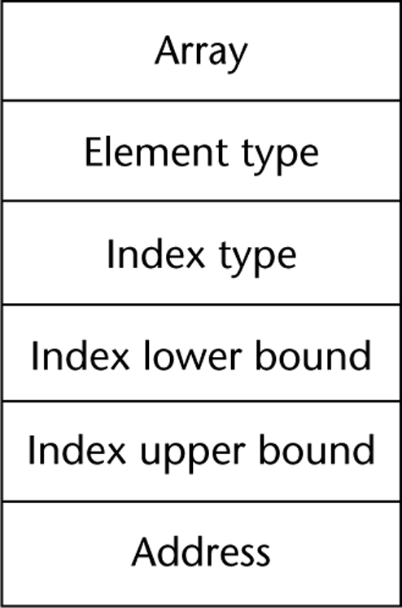
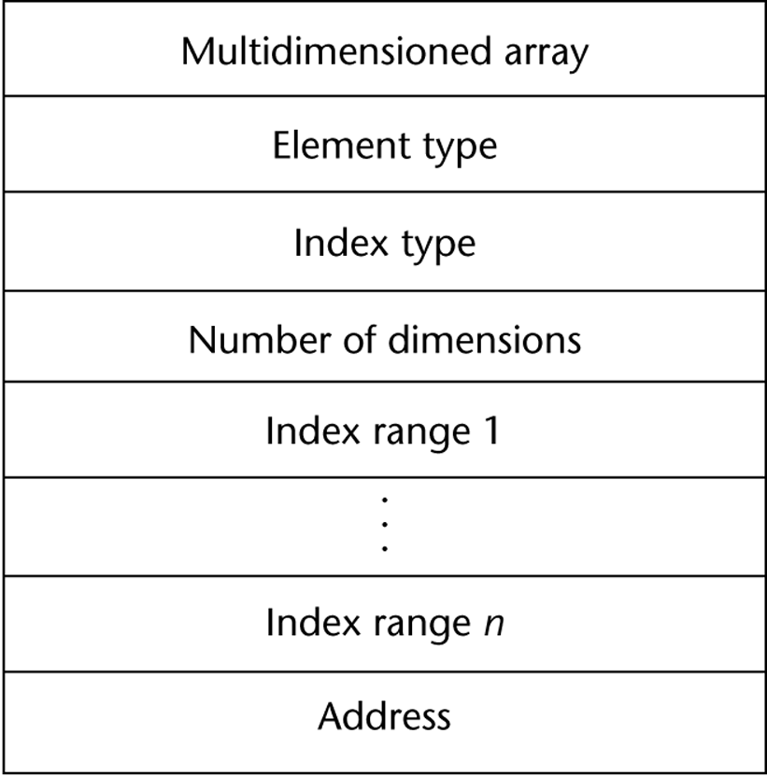
Array Descriptors
As with strings, arrays are commonly implemented by the compiler generating array descriptors for each array
  these descriptors include all information necessary to generate the mapping function
  in most languages, both the lower and upper bounds are required, in C/C++/Java/C#, lower bounds are always 0 and in FORTRAN, they are always 1
here we have
descriptors for
1-D and multi-D
arrays

Slide 17
Associative Arrays
An associative array uses a key to map to the proper location rather than an index
  keys are user-defined and must be stored in the data structure itself
  this is basically a hash table
Associative arrays are available in Java, Perl, and PHP, and supported in C++ as a class and Python as a type called a dictionary
  in Perl, associative arrays are implemented using a hash table and a 32-bit hash value, but, at least initially, only a portion of the hash value is used and stored, this is increased as needed if the hash table grows
  in PHP, associative arrays are implemented as linked lists with a hashing function that can point into the linked list
    see page 278 for some examples in Perl

Slide 18
Record Types
Heterogeneous aggregate of data elements
  elements referred to as fields or members
  introduced in COBOL
  incorporated into most languages since then
    Java does not have a record type but uses the class construct instead
  may be hierarchically structured (nested)
Design Issues:
  how to build hierarchical structure
  referencing of fields
  record operations and implementations
Examples:
COBOL (nested structure in one definition)
01 EMPLOYEE-RECORD.
02 EMPLOYEE-NAME.
05 FIRST PICTURE IS X(10).
05 MIDDLE PICTURE IS X(10).
05 LAST PICTURE IS X(20).
02 HOURLY-RATE PICTURE IS 99V99.
Ada (nested through multiple definitions)
type Employee_Name_Type is record
First : String(1..10);
Middle : String(1..10);
Last : String(1..10);
end record;
type Employee_Record is record
Employee_Name : Employee_Name_Type
Hourly_Rate : Float;
end record;

Slide 19
Record Operations
Assignment
  if both records are the same type
  allowed in Pascal, Ada, Modula-2, C/C++
Comparison (Ada)
Initialization (Ada, C/C++)
Move Corresponding (COBOL)
  copies input record to output file while possibly performing some modification
To reference an individual element:
  COBOL uses OF as in First OF Emp-Name
  Ada uses “.” as in Emp_Rec.Emp_Name.First
  Pascal, Modula-2 same as Ada but also allow a With statement so that variable names can be omitted
    with emp_record do
      begin
      first = …
      end;
  FORTRAN 90/95 use % sign as in Emp_Rec%Emp_Name%First
  PL/I and COBOL allow elliptical references where you only specify the field name if the name is unambiguous

Slide 20
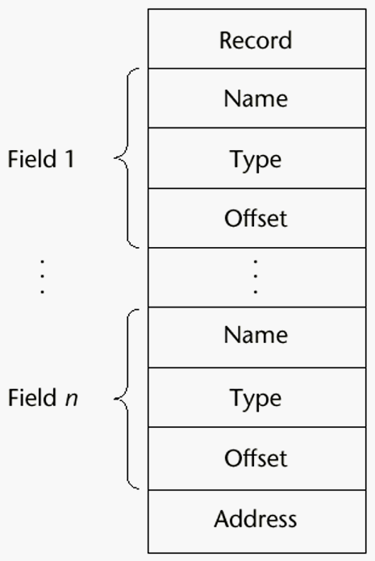
Record Implementation
Similar to Arrays, requires a mapping function
  since fields are statically defined, mapping function is determined at compile-time
  example:
A generic
compile-time
descriptor for
a record is
given to the right
type Foo is record
name : String(1..10);
sex : char;
salary : float;
end record;
If a variable, x, of type Foo starts at offset, then
x.name = offset
x.sex = offset + 10
x.salary = offset + 11
If we have an array a of Foo starting at index 0, then
a[i].name = offset + 12 * i
a[i].sex = offset + 12 * i + 10
a[i].salary = offset + 12 * i + 11
Notes:
C/C++ offers an interesting comparison between arrays and records. In most languages, both arrays and records are aggregate or container types where a mapping function is used to access any particular element. However, in C/C++, arrays are often accessed via pointer, and the array name is treated like a pointer, but C/C++ structs are not treated this way. I’m not sure why there is this discrepancy in how the two types of structures are treated, but this leads to a lack of orthogonality. In C/C++, passing an array is actually just passing a pointer to the array, thus saving time and space, but passing a struct means copying each individual member taking up time and space.

Slide 21
Union Types
Types which can store different types of variables at different times of execution
  FORTRAN’s Equivalence instruction:
    Integer X Real Y Equivalence (X, Y)
    declares one memory location for both X and Y
      the Equivalence statement is not a type, it just commands the compiler to share the same memory location
    in FORTRAN, there is no mechanism for the program to determine whether X or Y is currently stored in that location and so no type checking can be done
Other languages have union types
  the type defines 1 location for two variables of different types
  design issues:
    should type checking be required? If so, this must be dynamic type checking
    can unions be embedded in records?
Notes:
The rationale for Union types is twofold, neither of which is particularly relevant today:
To save memory space by reusing a memory location that had been allocated for a different variable. In this way, the same memory location might serve for multiple subroutines. Since today we have plenty of memory, and most languages use the run-time stack or heap for local subroutine variables, sharing of memory locations is no longer required or desirable.
To provide the programmer with flexibility in that a given memory location can be used for multiple types. For instance, this allows a programmer to get around type checking by storing (as an example) an int value but later interpreting it as a float. This is dangerous but programmers may find this useful in very rare cases.

Slide 22
Union Examples
A Free Union is a union in which no type checking is performed
  this is the case with FORTRAN’s Equivalence, and with C/C++ union construct
A Discriminating Union is a union in which a tag (also called a discriminant) is added to the memory location to determine which type is currently being stored
  ALGOL 68 introduced this idea and it is supported in Ada
  in ALGOL 68:
    UNION(int, real) ir1, ir2
  ir1 and ir2 share the same memory location which stores an int if it is currently ir1, and a real if it is currently ir2
      union (int, real) ir1; int count; ir1 := 33; count := ir1; (this statement is not legal)

Slide 23
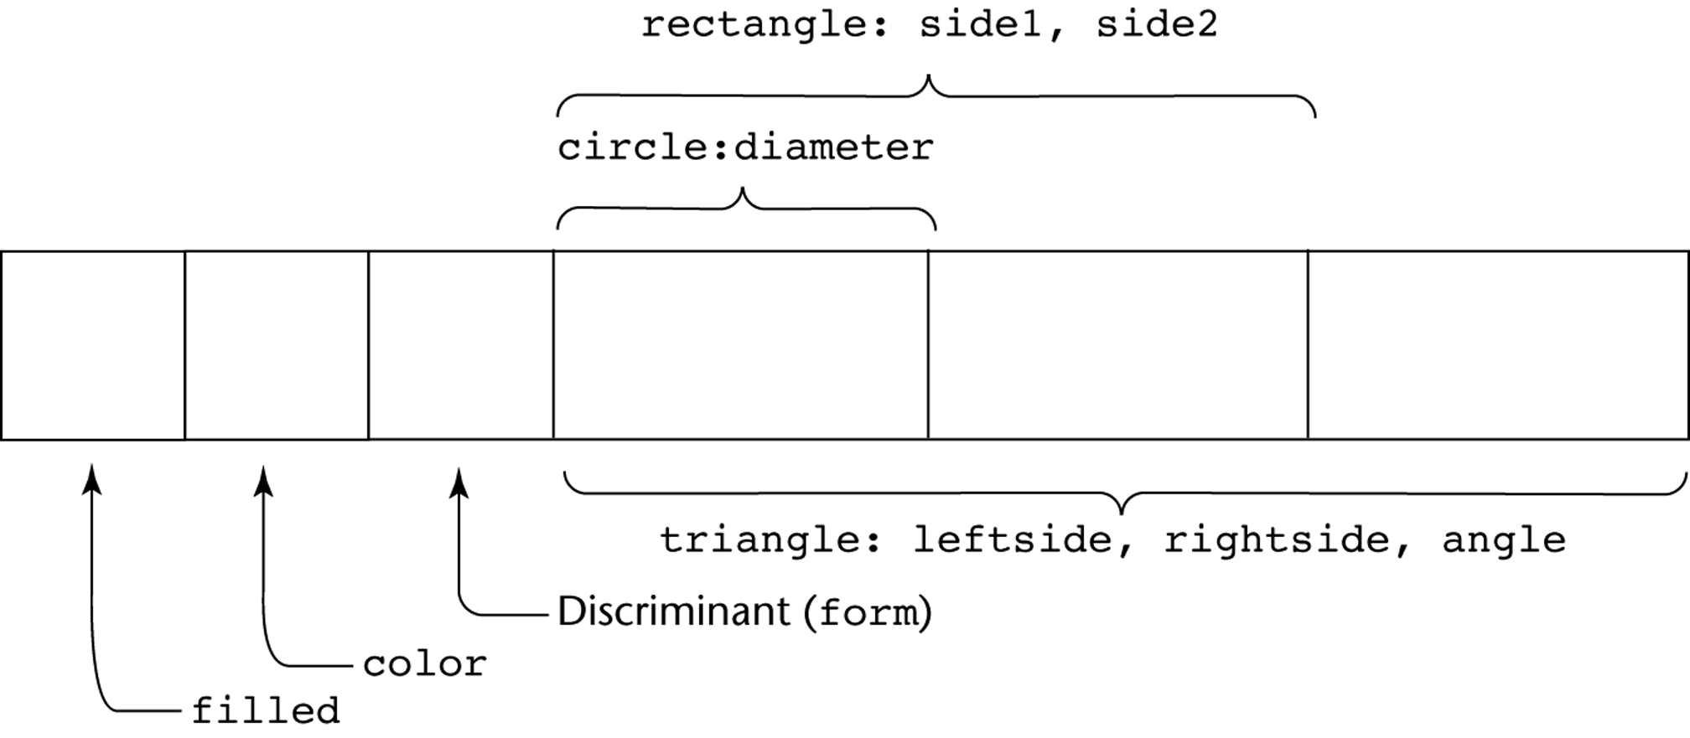
Variant Records
In Pascal, Ada, and Modula-2, another type of Union is available called the Variant Records
  in this case, the fields of a record are variable depending on the type of specific record
  here is a definition for a variant record in Pascal and the memory reserved for it:
type shape=(circle, triangle,rectangle);
type colors = (red, green, blue);
object = record
filled : boolean;
color : colors;
case form : shape of
circle : (diameter : real);
rectangle : (side1, side2 : integer);
triangle : (leftside, rightside : integer; angle : real);
end;
Notes:
Union types are often ignored or forgotten by today’s programmers. However, variant records are useful, at least in some contexts. For a language like Pascal which has no objects, the variant record provides a little bit of polymorphism.

Slide 24
Problems with Union Types
If the user program can modify the discriminant (tag), then the value(s) stored there are no longer what was expected
  for instance, consider changing the discriminant of our previous shape from triangle to rectangle, then the values of side1 and side2 are actually the old values of leftside and rightside, which are meaningless
Free unions are not type checked
  this gives the programmer flexibility but reduces reliability
Union types (whether free or discriminated) are hard to read and may not make much sense to those who have not used them
  Union types continue to be available in many modern languages so that the language is not strongly typed
    that is, unions are specifically made available to give the programmer a mechanism to avoid type checking!

Slide 25
Pointer Types
Used for indirect addressing for dynamic memory
  dynamic memory when allocated, does not have a name, so these are unnamed or anonymous variables and can only be accessed through a pointer
Pointers store memory locations or null
  usually null is a special value so that pointers can be implemented as special types of int values
By making pointers a specific type, some static allocation is possible
  the pointer itself can be allocated at compile-time, and uses of the pointer can be type checked at compile-time
Design issues:
  what is the scope and lifetime of the pointer?
  what is the lifetime of the variable being pointed to?
  are there restrictions on the type that a pointer can point to?
  should the pointer be implemented as a pointer or reference variable?
Notes:
Pointer scope and lifetime will probably be the same as any variable’s scope and lifetime – that is, this decision covers all types of variables, not just pointers
The lifetime of what is being pointed to is different, this is almost always a dynamic situation, allocated at run-time upon request (whether explicitly or implicitly as in Lisp or Perl).
The lifetime ends when the item is deallocated. This is explicit in many languages, but implicit in languages with a garbage collector – its lifetime ends when nothing points at it. Notice that the garbage collector may or may not retrieve that memory location immediately, so it still may be allocated, but inaccessible.

Slide 26
Pointer Operations
Pointer Access
  retrieve the memory location stored in the pointer
    if available, this can allow pointer arithmetic (e.g., C)
Dereferencing
  using a pointer to access the item being pointed to
Implicit Dereferencing
  dereferencing is done automatically when the pointer is accessed
    used in FORTRAN, ALGOL 68, Lisp, Java, Python
    in more recent languages, the pointer is not even treated (or called) a pointer because all access is done implicitly, this makes the use of the pointer much safer although far more restrictive
Explicit Dereferencing
  explicit command to access what the pointer is pointing too
    C/C++ use * (or -> for structs), Ada uses ., Pascal uses ^
Explicit Allocation
  used in C/C++ (malloc or new), PL/I (allocate), Pascal (new), etc
Explicit Deallocation
  used in Ada, PL/I, C, C++, and Pascal but not Java, Lisp or C#
    in many of these languages, while there is a command to deallocate memory, it is often not implemented so the result is that the pointer still points to memory!
Notes:
What is garbage collection? The process was invented by John McCarthy for Lisp, which performed automatically (or implicit) deallocation of memory – once a memory location was no longer pointed at, that location was made available for reuse.
The garbage collector process does not run continuously. Instead, it runs whenever the heap is low on memory. There are multiple strategies for garbage collection as the process can be time consuming. A memory location may contain a counter that indicates how many items point to it. As a pointer is set to point at a memory location, the counter is incremented and as a pointer is set to point somewhere else, this counter is decremented. Another option is set all memory locations as “not being pointed to” (a flag is associated with each location), and then follow all pointers and mark any location that is pointed at. Those flags that are set as not being pointed to can be cleaned up.
The actual search of memory looking for available memory locations can be performed by a sweep of memory (mark-and-sweep), a coloring algorithm, or by copying items pointed to to a contiguous block (updating all pointers) and then cleaning up the freed areas. If you are interested in reading up on the process, see http://en.wikipedia.org/wiki/Garbage_collection_(computer_science)

Slide 27
Pointer Problems
Type Checking
  if pointers are not restricted as to what they can point to, type checking can not be done at compile-time
    is it done at run-time (time consuming) or is the language unreliable?
    in C/C++, void * pointers are allowed which can point to any type
      dereferencing requires casting the value to permit some type checking
Dangling Pointers
  if a pointer is deallocated, then the memory that was being used is now returned to the heap
  if the pointer still retains the address, then we have a dangling pointer
    that is, the pointer may still be pointed at the deallocated value in memory
    this can lead to accessing something unexpected
Lost Heap-Dynamic Variables
  allocated memory which no longer has a pointer pointing at it can not be accessed – if the programmer is responsible for deallocating the memory, then this could result in heap memory that is not used by is not available
    in Java, C#, and Lisp, such items are automatically garbage collected
Pointer Arithmetic
  available in C/C++ which can lead to accessing the wrong areas of memory

Slide 28
Pointers in PLs
PL/I: first language to use pointers, very flexible which led to errors
ALGOL 68: less error due to explicitly declaring referenced type (type checking) and no explicit deallocation so no dangling pointers
Ada: memory can be automatically deallocated at the end of a block to lessen dangling pointers, but also has explicit deallocation if more desired
C/C++: extremely flexible pointers
  often used as a means of indirect addressing similar to assembly
  pointer arithmetic available for convenience in array accessing
FORTRAN 95: pointers can point to both heap and static variables but all pointers are required to have a Target attribute to ensure type checking
Java & C#: both use implicit pointers (reference types) although C# also has standard pointers
  C++ also has a reference type although used primarily for formal parameters in function definitions, which acts as a constant

Slide 29
Implementing Pointer Types
Pointers are implemented along with heap management
  the heap is a section of memory that is reserved for program allocation and deallocation
    pointers themselves are usually 2 or 4-byte int values storing addresses as offsets into the heap
  to deal with dangling ptrs:
    tombstones are special pointers that denote whether a given pointer’s memory is still allocated or has been deallocated
    locks and keys are two values stored with the pointer (key) and the allocated memory (lock)
      if the two values don’t match on an access, then it is a dangling pointer situation and access is disallowed
  heap management requires the ability to
    allocate memory
    restore the heap upon deallocation (or garbage collection)
      the book covers heap restoration in some detail (pages 300 – 304), but this is more an OS issue, so we won’t cover it here

